Slide 1
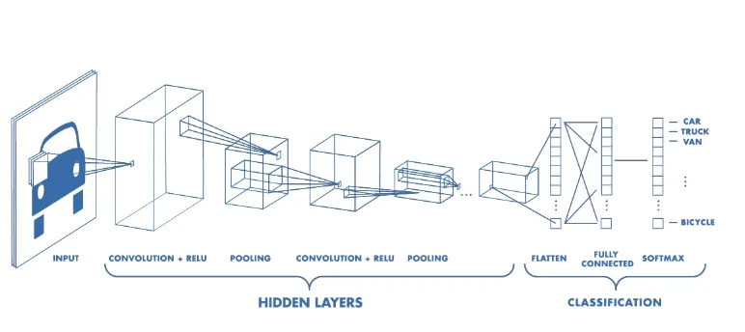
CNN MODEL
What is a CNN?
Notes:
A CNN uses “kernels” to extract features from an input image. A CNN is a neural network that functions primarily as an image classifier. It has a convulational layer, pooling layers and fully connected layers

Slide 2

Types of Parallelism
Data Parallelism
Model Parallelism
Split Layer Parallelism
Pipeline Parallelism
Tensor Parallelism
Notes:
DistributedDataParallel (pytorch) allows for data parallelism across multiple devices available. A bit more straightforward to handle compared to model parallelism, where the model itself is handled by multiple devices.

